Slide 1
Manipulating MySQL Databases with PHP

Slide 2
Credits
Some of the contents of this slide presentation have been referenced and reproduced from the textbook for this course, PHP Programming with MySQL (Second Edition) , Don Gosseling, Diana Kokoska, and Robert Easterbrooks, ©2011, Cengage Learning, All Rights Reserved. ISBN 978-0-5387-4584-0.
Thank you for some references to Kevin Skoglund, from PHP with MySQL Essential Training (2013), ©2017 LinkedIn Corporation.

Slide 3
LEARNING OBJECTIVES
Connect to MySQL from PHP
Work with MySQL databases using PHP
Working with MySQL tables with PHP
Use PHP to manipulate MySQL records
Use PHP to retrieve database records

Slide 4
Connecting to MySQL with PHP
Introduction
PHP was originally built with support for MySQL databases
PHP now has the ability to access and manipulate any database that is ODBC compliant
Open Database Connectivity
Some of the databases supported are MS SQL Server, Oracle, Informix, PostreSQL, and others
PHP includes functionality for working directly with different types of databases, without going through ODBC

Slide 5
Connecting to MySQL with PHP
Connecting to MySQL
Almost all of the functionality of MySQL Monitor and phpMyAdmin is available through PHP code
The differences is in learning some new functions to access MySQL with PHP
PHP is then capable of executing the same SQL statements available at the command line and through the GUI

Slide 6
Connecting to MySQL with PHP
Various PHP MySQL Packages
The earlier versions of PHP must use the mysql package
This package is deprecated in PHP Version 7 and much has been deprecated in PHP 5.5
The mysqli (MySQL Improved) package became available with PHP 5 and is designed to work with MySQL version 4.1.3 and later
The mysqli package is the object-oriented equivalent of the mysql package
It also works procedural for compatibility, we will use it

Slide 7

Connecting to MySQL with PHP
Opening and Closing a MySQL Connection
Open a connection to a MySQL database server with the mysqli_connect() function
The host argument specifies the host name where the MySQL database server is installed
The optional user and password arguments specify a MySQL account name and password

Slide 8
Connecting to MySQL with PHP
Opening and Closing a MySQL Connection
Open a connection to a MySQL database server with the mysqli_connect() function
The function returns a database connection if it connects to the database successfully, or FALSE if it does not
Use the variable to access the database in the PHP script
Close a database connection using the mysqli_close($DBConnect) function

Slide 9
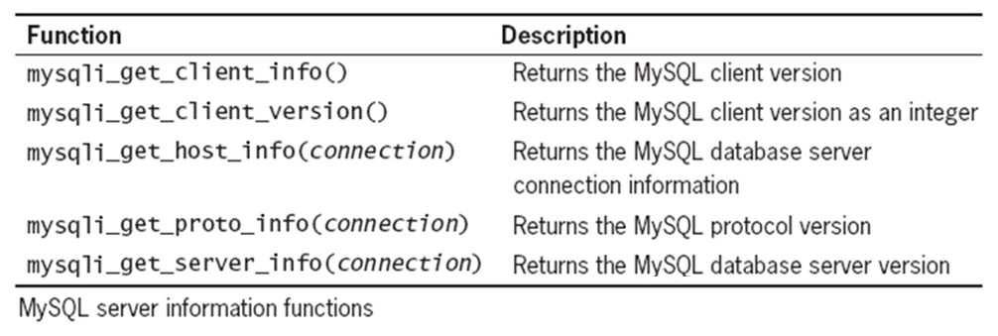
Connecting to MySQL with PHP
MySQL server Information Functions

Slide 10
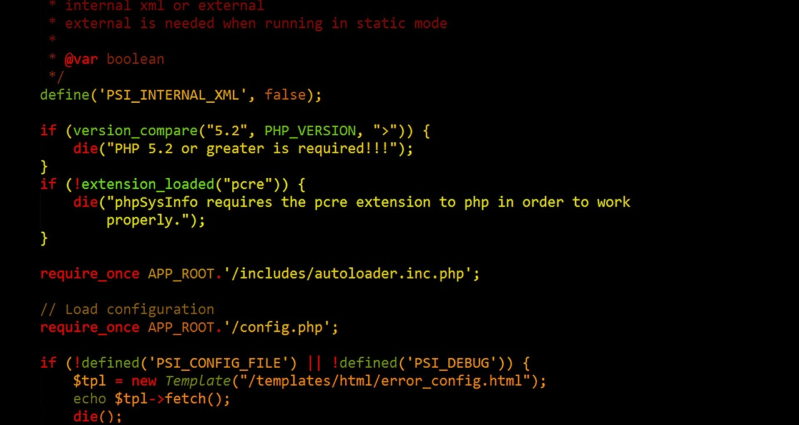
Connecting to MySQL with PHP
Programming Exercise 02_08_01 – Step 1
Connecting to MySQL with PHP

Slide 11
Working with MySQL Databases
Reporting MySQL Errors
The error functions only return the results of the previous MySQL function call
The mysqli_errno()function returns the error code, or 0 if no error occurred
The mysqli_error()function returns a text string describing the error
Reasons for not connecting to a DB server include:
The database server is not running
Insufficient privileges to access the data source
Invalid username and/or password

Slide 12
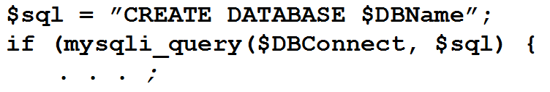
Working with MySQL Databases
Creating a Database
Use the mysqli_query()function to create a new database
Returns a Boolean TRUE on success, FALSE if there was an error

Slide 13
Working with MySQL Databases
Programming Exercise 02_08_01 – Step 2
Creating a Database

Slide 14

Working with MySQL Databases
Selecting a Database
Just as in MySQL Monitor, you must first select a database before using it
Use the mysqli_select_db()function to select a database
Returns a Boolean TRUE on success, FALSE if there was an error

Slide 15
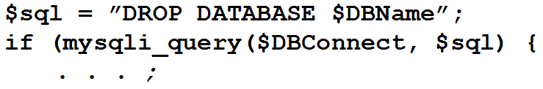
Working with MySQL Databases
Deleting a Database
Use the mysqli_query()function to delete a database
Returns a Boolean TRUE on success, FALSE if there was an error

Slide 16
Working with MySQL Databases
Programming Exercise 02_08_01 – Step 3
Selecting a Database

Slide 17
Working with MySQL Tables
Executing SQL Statements
Use the mysqli_query()function to send SQL statements to MySQL
For successful SELECT, SHOW, DESCRIBE, or EXPLAIN queries it returns a mysqli_result object, a result set
For other successful queries, returns a Boolean TRUE on success, FALSE if there was an error

Slide 18
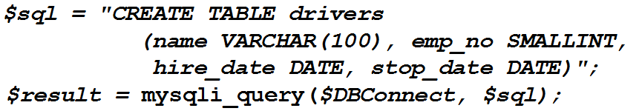
Working with MySQL Tables
Creating a Database Table
Use the CREATE TABLE statement with a mysqli_query()function to create a new table
On complex SQL, it is best to create it in phpMyAdmin or another GUI, then copy it into a PHP string
Returns a Boolean TRUE on success, FALSE if there was an error

Slide 19
Working with MySQL Tables
Creating and Deleting a Database Table
Additional keywords for the CREATE TABLE statement
To identify a field as a primary key, use the PRIMARY KEY keywords when defining a field
The AUTO_INCREMENT keyword is often used with a primary key to generate a unique ID for each new row in a table
The NOT NULL keywords are used with primary keys to require that a field include a value
To delete a table, use the DROP TABLE SQL statement with the mysql_query()function

Slide 20
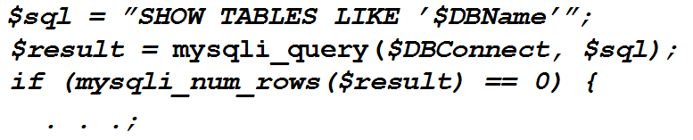
Working with MySQL Tables
Creating a Database Table
Use the SHOW TABLES LIKE statement with a mysqli_query()function to protect from trying to create a table that already exists
Follow it with a mysqli_num_rows()function, which must return a value of 0 rows to be safe

Slide 21
Working with MySQL Tables
Programming Exercise 02_08_01 – Step 4
Creating a Database Table

Slide 22

Manipulating MySQL Records
Adding Records to a Database Table
Use the INSERT INTO, and VALUES keywords with a mysqli_query()function to add individual records to table
Use the LOAD DATA statement with a mysqli_query()function with the name of a local text file containing records to add multiple records to table

Slide 23
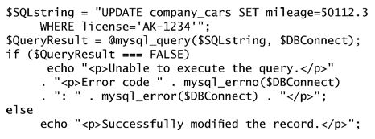
Manipulating MySQL Records
Updating Records in a Database Table
Use the UPDATE , SET, and WHERE keywords with a mysqli_query()function to update records in a table
UPDATE specifies the table name
SET specifies the field name and its new value
WHERE is used to pick records matching a condition

Slide 24
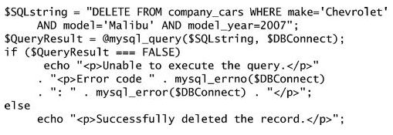
Manipulating MySQL Records
Deleting Records from a Database Table
Use the DELETE FROM keywords and an optional WHERE clause with a mysqli_query()function to delete individual records from a table
DELETE FROM specifies the table name
WHERE is used to pick records matching a condition
Omit the WHERE clause to delete ALL the records in the table

Slide 25
Manipulating MySQL Records
Programming Exercise 02_08_01 – Step 5
Adding Database Records

Slide 26
Retrieving MySQL Records
Using Functions to Indicate Query Results
For monitoring query errors, PHP provides the mysqli_error(), mysqli_errno(), and mysqli_error_list() functions
For monitoring query results, PHP provides the mysqli_num_rows(), mysqli_num_fields(), mysqli_info(), mysqli_affected_rows()functions
Each call returns information on the last query that was executed on the database connection

Slide 27
Retrieving MySQL Records
Using Functions to Indicate Query Results
With queries that return results (SELECT queries), mysqli_num_rows($DBConnect)produces the number of records returned from the query
With queries that return results (SELECT queries), mysqli_num_rows($DBConnect)gives the number of fields in a row returned from the query
With queries that modify tables, but don’t return results (SELECT, UPDATE, and DELETE queries), the number of records affected is shown by mysqli_affected_rows($DBConnect)

Slide 28
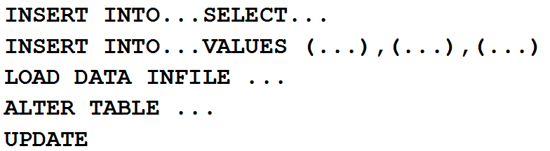
Retrieving MySQL Records
Using Functions to Indicate Query Results
For queries that add or update records, or alter a table’s structure, use the mysqli_info() function to return information about the query
The function returns the number of operations for various types of actions, depending on the type of query, to match one of the following
If no match, function returns an empty string

Slide 29
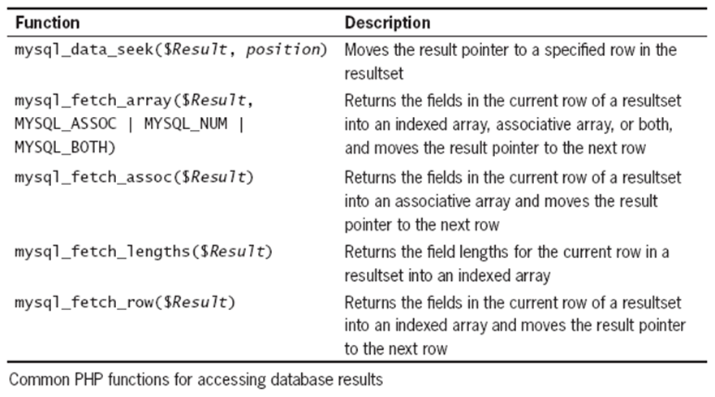
Retrieving MySQL Records
Working with Query Results
SQL queries that return results return a result pointer to a result set
Store it in a variable to access the result set

Slide 30
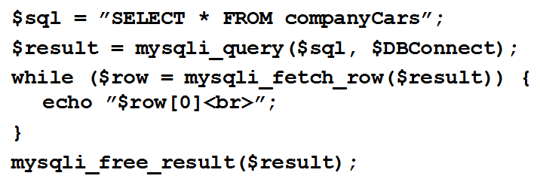
Retrieving MySQL Records
Retrieving Records into an Indexed Array
mysqli_fetch_row()returns the fields in the current row of a result set into an indexed array and moves the result pointer to the next row
To close the result set, and free its memory, use the mysqli_free_result($result)function

Slide 31
Retrieving MySQL Records
Programming Exercise 02_08_01 – Step 6
Retrieving Database Records – Indexed Array

Slide 32
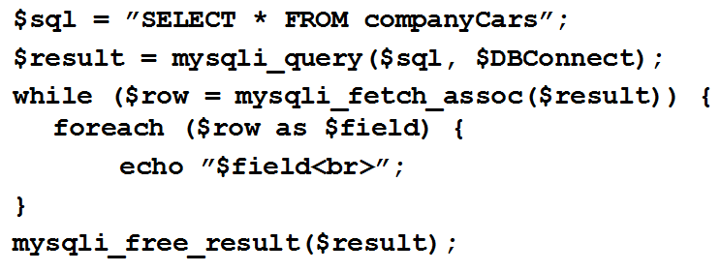
Retrieving MySQL Records
Retrieving Records into an Associative Array
mysqli_fetch_assoc()returns the fields in the current row of a result set into an associative array and moves the result pointer to the next row
To close the result set, and free its memory, use the mysqli_free_result($result)function

Slide 33
Retrieving MySQL Records
Programming Exercise 02_08_01 – Step 7
Retrieving Database Records – Associative Array

